Slide 1

CSE- 207
Algorithms
Lecture: 19
Shortest Path
Fahad Ahmed
Lecturer, Dept. of CSE
E-mail: fahadahmed@uap-bd.edu

Slide 2


Shortest Path

Slide 3
Shortest Path
Applicable for directed weighted graph.
Available paths from A to E
  A->B->E = 10
  A->C->D->E=6
  A->C->D->B->E=6
  A->E = 5
5
5
5
5
5
1
1
1
1
9
1
9
9
9
9
B
B
B
B
B
E
E
E
E
A
E
A
A
A
A
1
1
1
1
1
1
1
1
1
1
2
2
2
2
2
C
C
C
C
C
D
D
D
D
D
3
3
3
3
3

Slide 4
Shortest Path
The shortest path problem is the problem of finding a path between two vertices (or nodes) in a graph such that the sum of the weights of its constituent edges is minimized
Applicable for directed weighted graph.
Available paths from A to E
  A->B->E = 10
  A->C->D->E=6
  A->C->D->B->E=6
  A->E = 5
Shortest among all available path = 5
5
9
B
1
E
A
1
1
2
C
D
3

Slide 5

Shortest Path - definition
Given a weighted, directed graph G = (V,E) , with weight function w : E -> R mapping edges to real-valued weights.
The weight w(p) of path p = <v₀, v₁, . . ., v_{k}> is the sum of the weights of its constituent edges:
We define the shortest-path weight δ(u, v) from u to v by
A shortest path from vertex u to vertex v is then defined as any path p with weight
w(p) =δ(u,v)

Slide 6
Shortest-Path Variants :
Shortest-Path problems
  Single-source shortest-paths problem: Find the shortest path from s to each vertex v. (e.g. BFS)
  Single-destination shortest-paths problem: Find a shortest path to a given destination vertex t from each vertex v.
  Single-pair shortest-path problem: Find a shortest path from u to v for given vertices u and v.
  All-pairs shortest-paths problem: Find a shortest path from u to v for every pair of vertices u and v.

Slide 7
Shortest Path - variants
Restrictions on edge weight
  Non-negative
  Arbitrary weight
  Euclidean weight
Cycles?
  No directed cycle
  No negative cycle.

Slide 8
Applications
Google map to find shortest distance from one location to another
Robot navigation
Urban traffic planning
Optimal pipelining of VLSI chip

Slide 9

How to solve
There are exponential number of ways to get from one vertex to another.
So, try all possible combination and select the shortest one.

Slide 10
Generic Algorithm
Algorithm:
    Initialize d[s]=0 and d[v]=∞ for all other vertices.
    Repeat until optimal condition is satisfied, select edge (u,v)
    Relax edge (u,v)

Slide 11
Relaxation
Relaxation:
  If d[v]>d[u]+w(u,v)
  d[v]= d[u]+w(u,v)
  ∏[v]=u
d[v]
d[v]
s
v
d[v]>d[u]+w(u,v)
s
v
w(u, v)
w(u, v)
d[u]
d[u]
u
u

Slide 12
Relaxation – example
Relaxation:
  If d[v]>d[u]+w(u,v)
  d[v]= d[u]+w(u,v)
  ∏[v]=u
d[v] = 15
s
v
s
v
d[v]>d[u]+w(u,v)
w(u, v) = 5
5
d[u] = 8
8
u
u

Slide 13
Optimal Condition
For all edges, d[v]≤d[u] +w(u, v) [i.e. we found shortest path for all vertices]

Slide 14
Generic Algorithm
5
5
5
5
5
d[B] = 9
d[B] = 9
d[B] = 9
d[E] = 5
d[E] = 5
d[E] = 5
d[E] = 5
9
9
9
9
9
B
B
B
B
B
E
E
E
E
A
E
A
A
A
A
1
1
1
1
1
1
1
1
1
1
2
2
2
2
2
C
C
C
C
C
D
D
D
D
D
3
3
3
3
d[C] = 2
3
d[C] = 2
d[D] = 5

Slide 15
Generic Algorithm
5
d[D]+w(D,B) = 5+1=6 < d[B]
So there is a shorter way to get to B via D node.
d[B] = 9
d[E] = 5
9
B
E
A
1
1
2
C
D
d[C] = 2
3
d[D] = 5

Slide 16
Generic Algorithm
Relaxation:
  If d[v]>d[u]+w(u,v)
  d[v]= d[u]+w(u,v)
  ∏[v]=u
5
d[D]+w(D,B) = 5+1=6 < d[B]
So, Relax edge (D,B)
-means remove the AB path and add DB to get to node B
d[B] = 6
d[E] = 5
9
B
E
A
1
1
2
C
D
d[C] = 2
3
d[D] = 5

Slide 17
Generic Algorithm
Optimal Condition:
For all edges, d[v]≤d[u] +w(u, v) [i.e. we found shortest path for all vertices]
5
d[E] = 5
9
B
E
A
Haven’t check the (D,E) edge yet.
1
1
2
C
D
d[C] = 2
3
d[D] = 5

Slide 18
Generic Algorithm
Optimal Condition:
For all edges, d[v]≤d[u] +w(u, v) [i.e. we found shortest path for all vertices]
5
d[E] = 5
9
B
E
A
d[E] < d[D] +w(D,E).
So, no need to relax.
1
1
2
C
D
d[C] = 2
3
d[D] = 5

Slide 19
Generic Algorithm
Efficient Implementations:
  How to choose which edge to relax?
  Ans: Greedy Algorithm
    Dijkstra’s algorithm (non-negative weights)
      O(V lg V+E) = O(E) as E=O(V² )
    Bellman-Ford algorithm (no negative cycles)
      O(VE)

Slide 20
Some notation
d(v) – distance to v from source node
∏[v]: predecessor on current best path to v.
δ(v) – shortest path from source to v.

Slide 21
Greedy Algorithm

Slide 22
Optimal substructure
Shortest-paths algorithms typically rely on the property that a shortest path between two vertices contains other shortest paths within it.
Subpath of a shortest path is also a shortest path
If shortest path from s to d,
  δ(s, d) = p_{i} + p_{j} + p_{d}
  Then p_{i} , p_{j} , and p_{d} are also shortest path
p_{i}
p_{j}
p_{d}
V_{s}
V_{i}
V_{j}
V_{d}

Slide 23
Optimal substructure
Formal def:
  Given a weighted, directed graph G = (V,E) with weight function w : E -> R, let p = (v₀, v₁, . . ., v_{k}) be a shortest path from vertex 0 to vertex k and, for any i and j such that 0 ≤ i ≤ j ≤ k, let p_{ij} = (v_{i}, v_{i+1}, . . ., v_{j}) be the subpath of p from vertex i to vertex j . Then, p_{ij} is a shortest path from i to j .

Slide 24
Triangle inequality
If v₁, v₂, v₃ forms a triangle and δ(v₁,v₂), δ(v₁,v₃) and δ(v₃,v₂) are shortest paths between 2 vertices than we can write
  δ(v₁,v₂) < δ(v₁,v₃)+ δ(v₃,v₁)
δ(v₁,v₂)
V₂
V₁
δ(v₃,v₂)
δ(v₁,v₃)
V₃

Slide 25
Dijkstra’s Algorithm

Slide 26
Dijkstra’s Algorithm
Requirement/criteria
  all edge weights are nonnegative.
It maintain 2 lists.
  set S of vertices whose final shortest-path weights from the source s have already been determined.
  Another list Q for the vertices shortest-path weights has not been determined.
  At each pass a vertex u will move from Q to S.
    And relaxes all edges leaving u

Slide 27
Dijkstra’s Algorithm
//Greedy Choice: A vertex from Q with the least distance is selected
// Vertex 'u' is added to 'S' list of vertices that have been

Slide 28
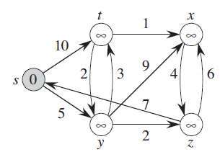
Dijkstra’s Algorithm - example
S=S U {u} | Q {s t x y z} | {u}
{} | {0 ∞ ∞ ∞ ∞}
|Q|=5

Slide 29
Dijkstra’s Algorithm - example
S=S U {u} | Q {s t x y z} | {u}
{} | {0 ∞ ∞ ∞ ∞} | {s}
|Q|=5

Slide 30
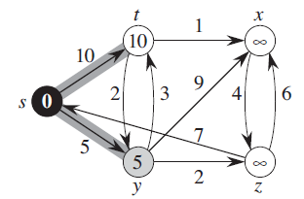
Dijkstra’s Algorithm - example
S=S U {u} | Q {s t x y z} | {u}
{} | {0 ∞ ∞ ∞ ∞} | {s}
{s} | {0 10 ∞ 5 ∞}
|Q|=4

Slide 31
Dijkstra’s Algorithm - example
S=S U {u} | Q {s t x y z} | {u}
{} | {0 ∞ ∞ ∞ ∞} | {s}
{s} | {0 10 ∞ 5 ∞} | {y}
|Q|=4

Slide 32
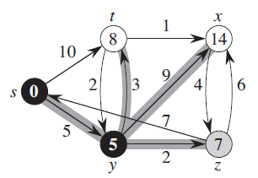
Dijkstra’s Algorithm - example
S=S U {u} | Q {s t x y z} | {u}
{} | {0 ∞ ∞ ∞ ∞} | {s}
{s} | {0 10 ∞ 5 ∞} | {y}
{s, y} | {0 8 14 5 7}
|Q|=3

Slide 33
Dijkstra’s Algorithm - example
S=S U {u} | Q {s t x y z} | {u}
{} | {0 ∞ ∞ ∞ ∞} | {s}
{s} | {0 10 ∞ 5 ∞} | {y}
{s, y} | {0 8 14 5 7} | {z}
|Q|=3

Slide 34
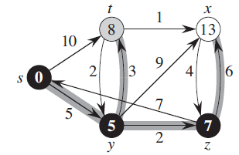
Dijkstra’s Algorithm - example
S=S U {u} | Q {s t x y z} | {u}
{} | {0 ∞ ∞ ∞ ∞} | {s}
{s} | {0 10 ∞ 5 ∞} | {y}
{s, y} | {0 8 14 5 7} | {z}
{s, y, z} | {0 8 13 5 7}
|Q|=2

Slide 35
Dijkstra’s Algorithm - example
S=S U {u} | Q {s t x y z} | {u}
{} | {0 ∞ ∞ ∞ ∞} | {s}
{s} | {0 10 ∞ 5 ∞} | {y}
{s, y} | {0 8 14 5 7} | {z}
{s, y, z} | {0 8 13 5 7} | {t}
|Q|=2

Slide 36
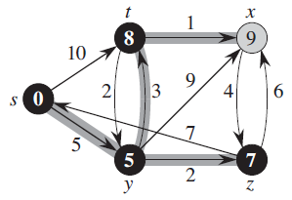
Dijkstra’s Algorithm - example
S=S U {u} | Q {s t x y z} | {u}
{} | {0 ∞ ∞ ∞ ∞} | {s}
{s} | {0 10 ∞ 5 ∞} | {y}
{s, y} | {0 8 14 5 7} | {z}
{s, y, z} | {0 8 13 5 7} | {t}
{s, y, z, t} | {0 8 9 5 7}
|Q|=1

Slide 37
Dijkstra’s Algorithm - example
S=S U {u} | Q {s t x y z} | {u}
{} | {0 ∞ ∞ ∞ ∞} | {s}
{s} | {0 10 ∞ 5 ∞} | {y}
{s, y} | {0 8 14 5 7} | {z}
{s, y, z} | {0 8 13 5 7} | {t}
{s, y, z, t} | {0 8 9 5 7} | {x}
|Q|=1

Slide 38
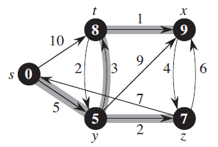
Dijkstra’s Algorithm - example
S=S U {u} | Q {s t x y z} | {u}
{} | {0 ∞ ∞ ∞ ∞} | {s}
{s} | {0 10 ∞ 5 ∞} | {y}
{s, y} | {0 8 14 5 7} | {z}
{s, y, z} | {0 8 13 5 7} | {t}
{s, y, z, t} | {0 8 9 5 7} | {x}
{s, y, z, t,x} | {0 8 9 5 7}
|Q|=0

Slide 39
Time complexity
Depends on how many times each operation takes place:
  Inserts in Priority queue – V times
  Extract min operation – V times
  Decrease key operation(relaxation) - E times

Slide 40
Time complexity – with different data structure
With Array
  (1) – insert
  (V)- Extract min
  (1) – decrease key
  Total = V* (1) + V*(V) +E*(1)= (E) + (V²) = (V²)
Binary mean heap
  (lg V) – insert
  (lg V)- Extract min [deleting min is constant but resorting/updating after delete will take lg V]
  (lg V) – decrease key
  Total = V* (lg V) + V*(lg V) +E*(lg V)= (E lg V)
Fibonacci heap :
  (1) – insert
  (lg V)- Extract min
  (1) – decrease key
  Total = V* (1) + V*(lg V) +E*(1)= (E + V lg V)

Slide 41
Time complexity – summary
Data Structure used | Insert (V times) | Extract-min (V times) | Decrease key(E times) | Total
Array | (1) | (V) | (1) | (V²)
Binary Heap | (lg V) | (lg V) | (lg V) | (E lg V)
Fibonacci Heap | (1) | (lg V) | (1) | (E + V lg V)

Slide 42
Negative weight vs. negative cycle
If the graph G (V,E) contains no negative weight cycles reachable from the source s,
  then for all vertices v  V , the shortest-path weight δ(s, v) remains well defined, even if it has a negative value.
If the graph contains a negative-weight cycle reachable from s
  shortest-path weights are not well defined.

Slide 43
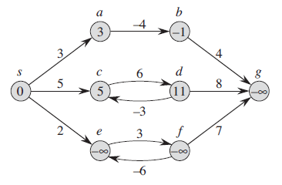
Negative weight vs. negative cycle
Path weight of e and f continues to decrease as we follow the loop.
As a result weight for g will also keep decreasing.
So, path of these 3 nodes become undefined.

Slide 44
Negative weight vs. negative cycle
On the contrary even though path to b contains a negative weight but as there is no negative cycle, b will have a defined shortest path.
Also c and d has a cycle but not negative cycle. So, they also have defined shortest path.

Slide 45
Why would one ever have edges with negative weights in real life?
Negative weight edges might seem useless at first but they can explain a lot of phenomena like cashflow, the heat released/absorbed in a chemical reaction, etc.
For instance, if there are different ways to reach from one chemical A to another chemical B, each method will have sub-reactions involving both heat dissipation and absorption.
If we want to find the set of reactions where minimum energy is required, then we will need to be able to factor in the heat absorption as negative weights and heat dissipation as positive weights.

Slide 46
Bellman-Ford algorithm

Slide 47
Bellman-Ford algorithm
The Bellman-Ford algorithm solves the general case in which edge weights may be negative.
Given a weighted, directed Graph G(V,E ) with source s and weight function w,
  It returns a boolean value indicating whether or not there is a negative-weight cycle that is reachable from the source.
  If there is such a cycle, the algorithm indicates that no solution exists.
  If there is no such cycle, the algorithm produces the shortest paths and their weights.
  The algorithm returns TRUE if and only if the graph contains no negative-weight cycles that are reachable from the source.

Slide 48
Bellman-Ford algorithm
Bellman-Ford works better (better than Dijkstra’s) for distributed systems.
Bellman-Ford does not work with undirected graph with negative edges as it will declared as negative cycle

Slide 49
Bellman-Ford algorithm
At each iteration, at least one vertex reachable from s will have the shortest path.
So, after V-1 iteration all V-1 vertices will have their shortest path
If we can farther reduce the cost then there is a cycle
Overall time complexity: O(|V|*|E|)

Slide 50
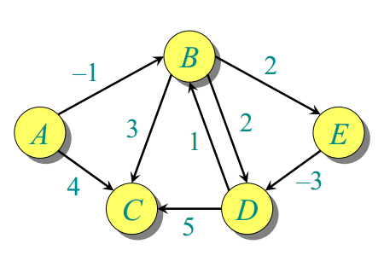
Bellman-Ford algorithm - Example

Slide 51
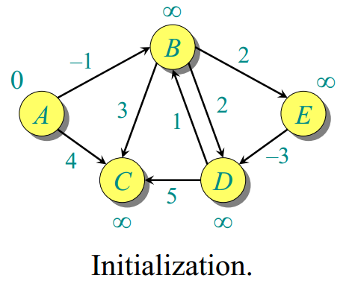
Bellman-Ford algorithm - Example

Slide 52
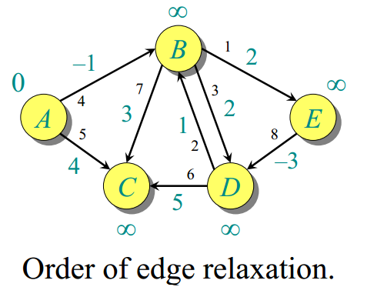
Bellman-Ford algorithm - Example

Slide 53
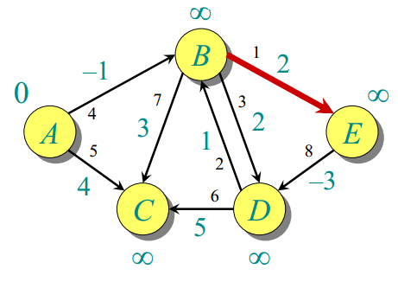
Bellman-Ford algorithm - Example

Slide 54
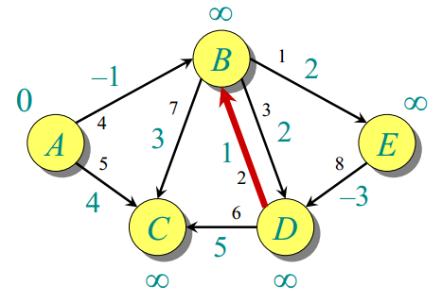
Bellman-Ford algorithm - Example

Slide 55
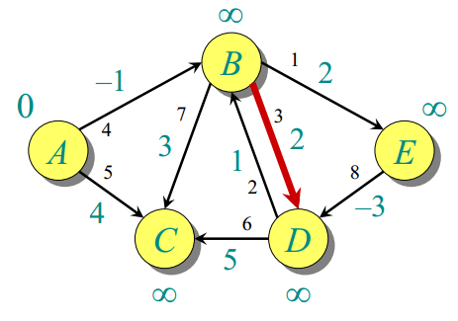
Bellman-Ford algorithm - Example

Slide 56
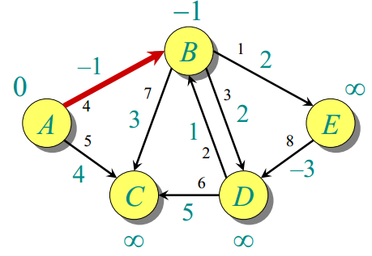
Bellman-Ford algorithm - Example

Slide 57
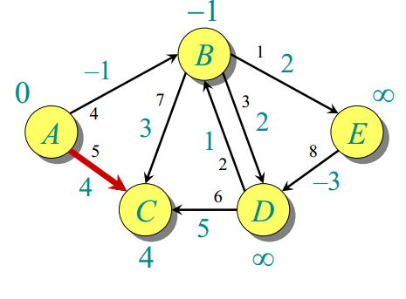
Bellman-Ford algorithm - Example

Slide 58
Bellman-Ford algorithm - Example

Slide 59
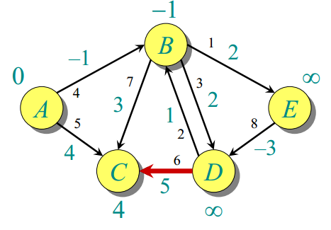
Bellman-Ford algorithm - Example

Slide 60
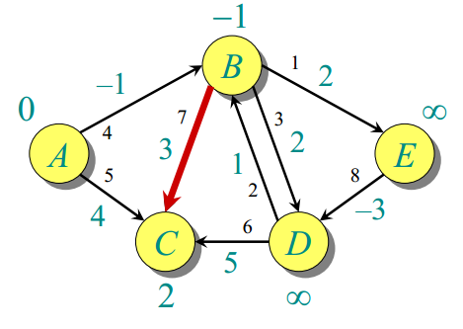
Bellman-Ford algorithm - Example

Slide 61
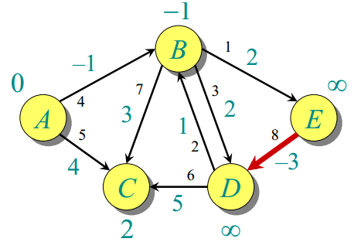
Bellman-Ford algorithm - Example

Slide 62
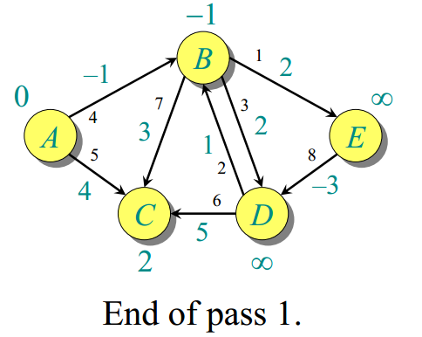
Bellman-Ford algorithm - Example

Slide 63
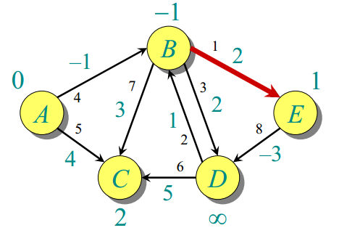
Bellman-Ford algorithm - Example

Slide 64
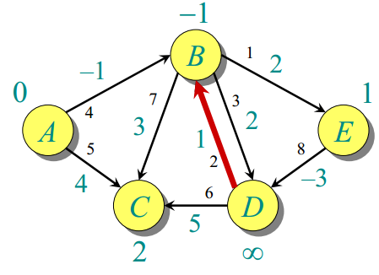
Bellman-Ford algorithm - Example

Slide 65
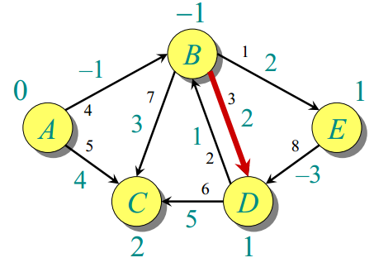
Bellman-Ford algorithm - Example

Slide 66
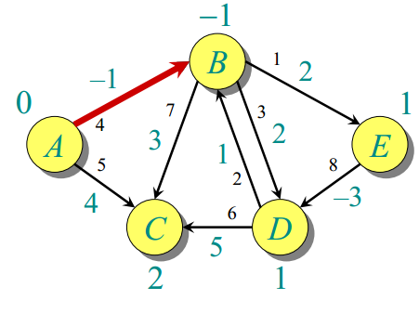
Bellman-Ford algorithm - Example

Slide 67
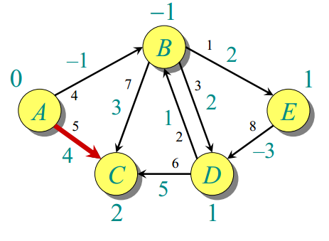
Bellman-Ford algorithm - Example

Slide 68
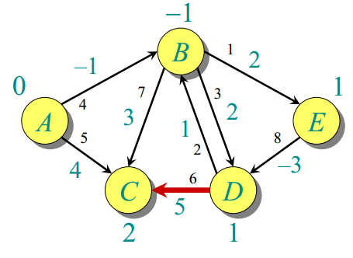
Bellman-Ford algorithm - Example

Slide 69
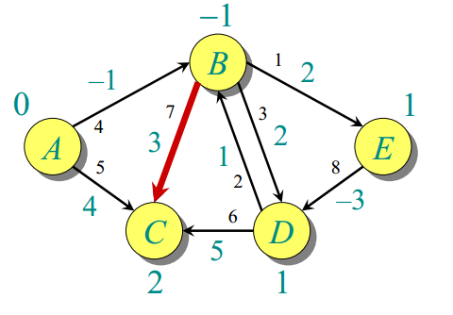
Bellman-Ford algorithm - Example

Slide 70
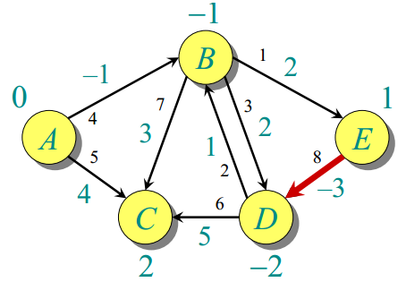
Bellman-Ford algorithm - Example

Slide 71
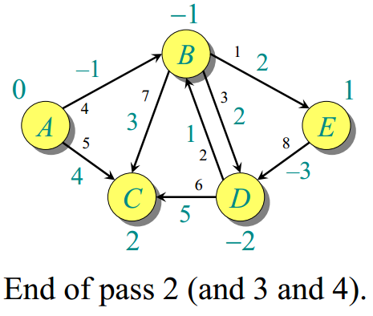
Bellman-Ford algorithm - Example

Slide 72
Try at home
Increase all weights by a fixed number.
How to convert single source Shortest Path to a Single Destination Shortest path algorithm.
Apply Dijkstra to a graph with negative weight/cycle.

Slide 73
Reference
Chapter 24 (Cormen) -> 24.1, 24.3

